Slide 1
Customer, Agent and Sales Analysis(using SQL)
An end-to-end project covering data cleaning, analysis, and business insights
Tanupriya Awasthi
31/07/2025

Slide 2
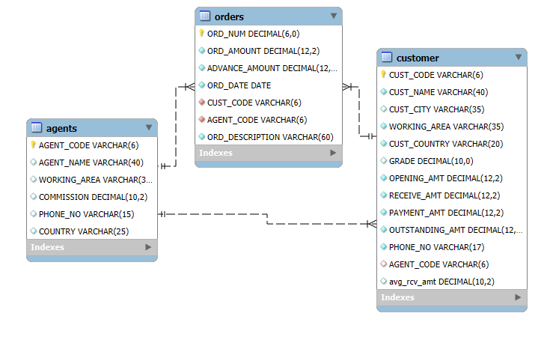
Project Objectives
Understand the structure of three core tables: agents, customer, and orders
Clean and prepare data for analysis
Derive key sales trends, customer behavior , and agent performance insights
Implement SQL procedures and functions for automation

Slide 3
Data Cleaning & Preparation
Removed extra spaces, cleaned phone numbers, and normalized text values
Verified appropriate data types using DESC and analysis
Checked for duplicates and added foreign key constraints
Ensured referential integrity between tables.
Added primary key as well.

Slide 4
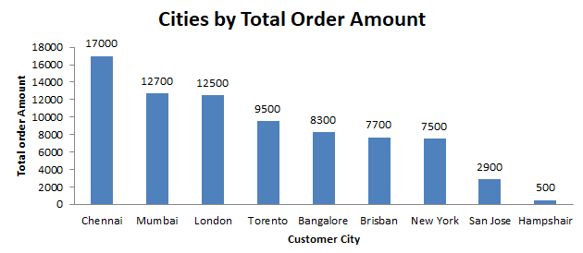
Sales Performance Analysis
Chennai , Mumbai and London are the top 3 cities by total order amount.
Hampshair has the lowest order amount in total hence we should find the reasons for this and should try to increase the sales by advertising and camapings and can offer discounts.

Slide 5
Total Revenue 78600
Average order value 2183.33
Total Orders 36

Slide 6
Customer Behavior Analysis
Ramanathan , Holmes and Karolina are top 3 customers with total revenue of 10500, 6000, 5500 respectively.

Slide 7
In total there are 25 customers.
Retention rate is 32%

Slide 8
Agent’s Performance Evaluation
These are the top 5 agents who have generated more revenue.
If the company decides to provide some appreciated to encourage its agents then it an provide bonus to these . This will encourage other agents as well to generate more revenue.

Slide 9
Agents by order count
Agent Mukesh has the highest number of order count followed by Santakumar.
The lower order count is 1 and there are two agents with lost order count namely Benjamin and Subbarao.

Slide 10
Commission Based on Average Advance Amount
Commission adjustment logic based on average advance amount (750–1000 → ×1.5 | >1000 → ×2)
Agent Name | Order count | Total revenue | Average advance amount | Commission | Updated Commission
Alex | 2 | 3500 | 500 | 0.13 | 0.13
Santakumar | 5 | 17000 | 740 | 0.14 | 0.14
Ramasundar | 2 | 2500 | 250 | 0.15 | 0.15
Mukesh | 7 | 12700 |  | 0.11 | 0.11
Lucida | 2 | 2900 |  | 0.12 | 0.12
Alford | 3 | 7500 |  | 0.12 | 0.24
Ivan | 4 | 9500 |  | 0.15 | 0.15
McDen | 2 | 3000 | 300 | 0.15 | 0.15
Ravi Kumar | 2 | 5000 | 500 | 0.15 | 0.15
Anderson | 3 | 7700 | 225 | 0.13 | 0.26
Subbarao | 1 | 800 | 1100 | 0.14 | 0.14
Benjamin | 1 | 500 | 525 | 0.11 | 0.11

Slide 11
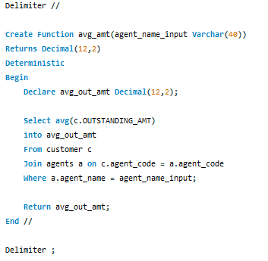
Automation via SQL Procedures and Functions
Created UDF: avg_amt() – Returns avg outstanding by agent

Slide 12
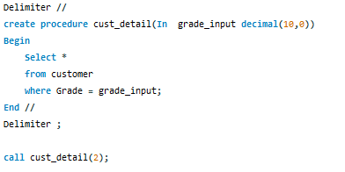
Procedure: cust_detail() – Fetch customer details by grade

Slide 13
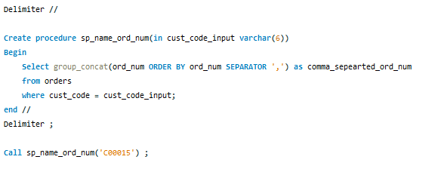
Procedure: sp_name_ord_num() – Get comma-separated order numbers for a customer

Slide 14
Insights & Impact
Enabled better decision-making via clean, structured data
Identified top revenue sources and high-value customers
ff
Identified top performing agents
Calculated the total number of customers and the retention rate.

Slide 15
Identified the customers with the maximum outstanding amount for each country.
Identified top performing cities on the basis of total revenue generated.
Evaluated the agents performance and calculated the updated commission as an appraisal.
Automated repetitive queries through procedures and functions

Slide 16


